Slide 1



Industry 4.0, Predictive maintenance & IoT: AN introduction
Silvio Ranise – Head of the Security & Trust Research Unit
ranise@fbk.eu / http://st.fbk.eu/SilvioRanise
Notes:
http://www.beechamresearch.com/article.aspx?id=4

Slide 2
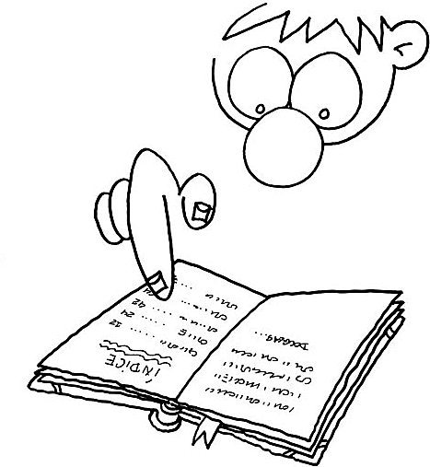
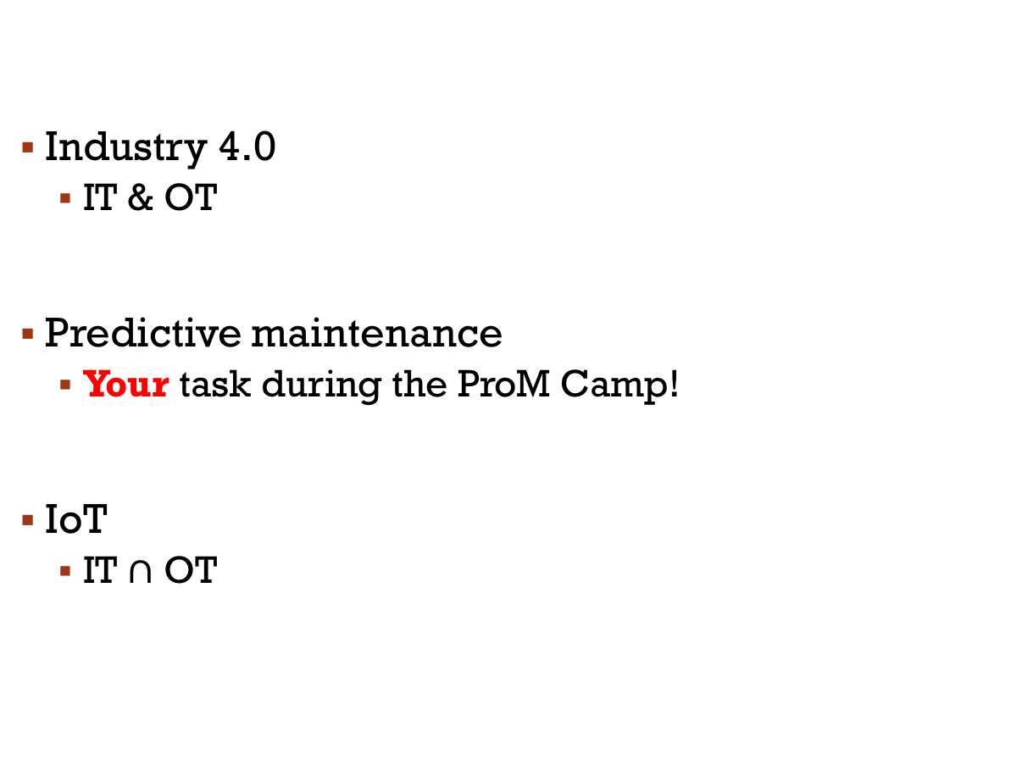
contents
Industry 4.0
IT & OT
Predictive maintenance
Your task during the ProM Camp!
IoT
IT $∩$ OT

Slide 3

disclaimer
Many of the slides are shamelessly stolen from Marco Roveri
You will see him around…

Slide 4
Industry 4.0

Slide 5
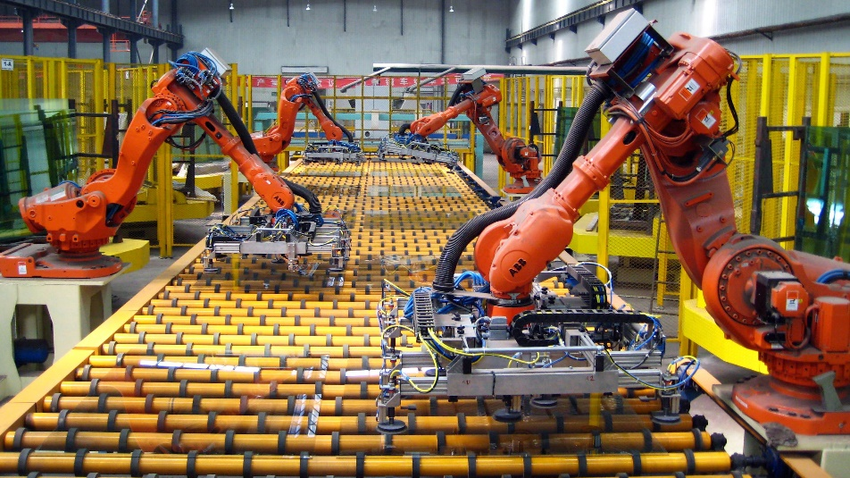
An Industry Revolution: Industry 4.0
The manufacturing sector moves from a laborious mass production model to
an integrated, seamless automated factory
Digitalizing/virtualizing the entire product value chain,
optimizing production processes
the integration of networked communication systems.
[“Industrie 4.0”: Industry 4.0 Working Group, October 2012]
Notes:
http://www.theatlantic.com/magazine/archive/2015/07/world-without-work/395294/

Slide 6
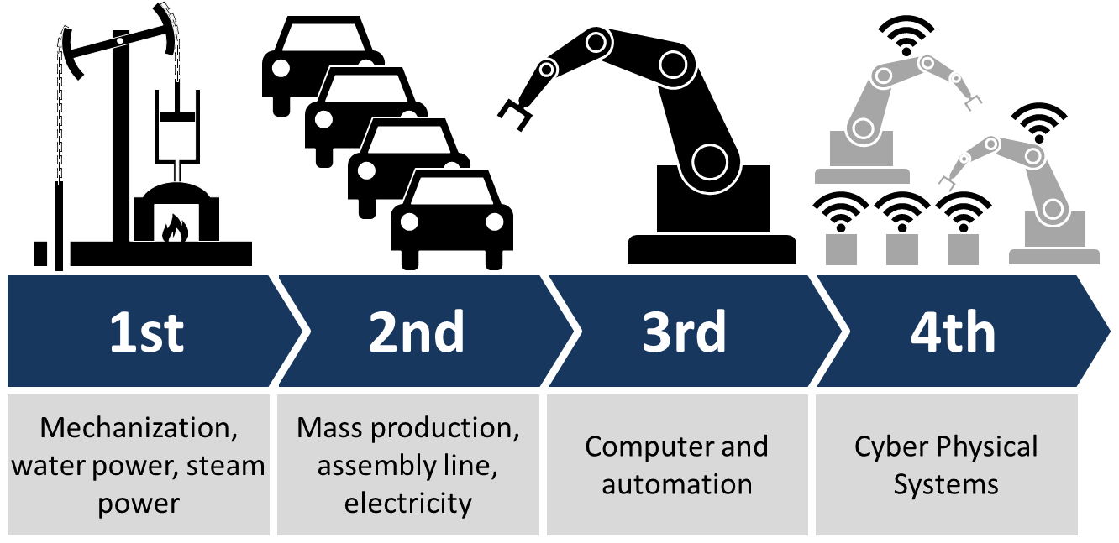
The 4th Industrial Revolution
Industry 4.0:
systems controlled/monitored by computers
tightly integrated with the Internet and its users
automation – IoT – Cloud Computing – Cognitive Computing
Notes:
http://www.theatlantic.com/magazine/archive/2015/07/world-without-work/395294/

Slide 7
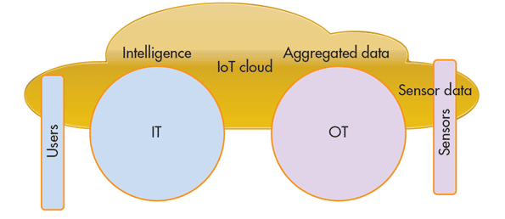
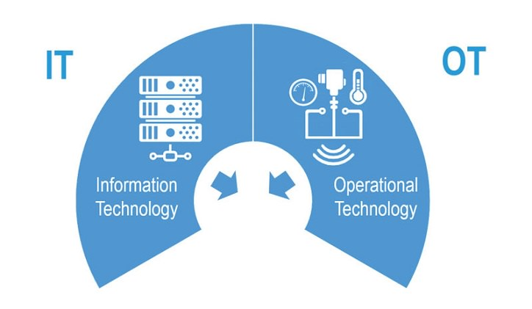
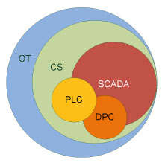
“IT + OT = Industry 4.0”
IT = Information Technology
OT = Operational Technology
IoT = Internet of Things
ICS = Industrial Control System
PLC = Programmable Logic Controller
DPC =
SCADA = Supervisory Control and Data Acquisition
IoT

Slide 8
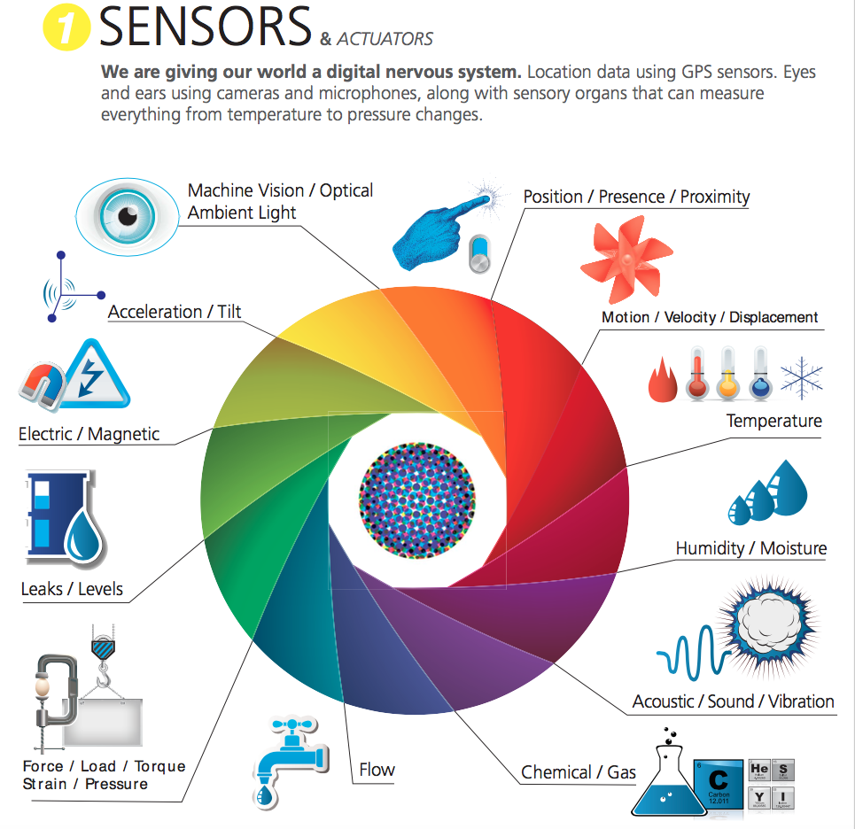

Slide 9
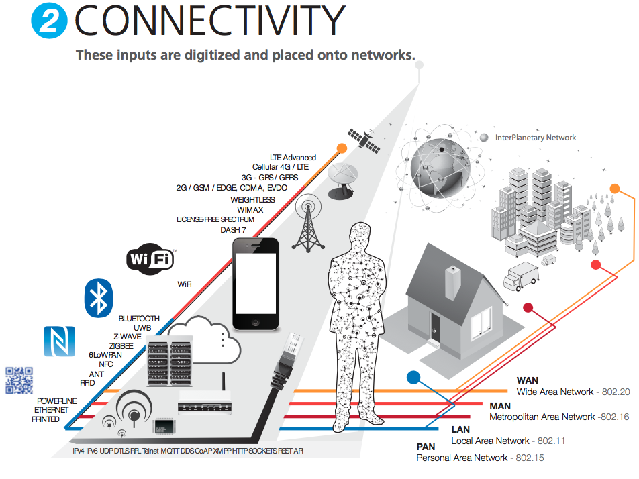
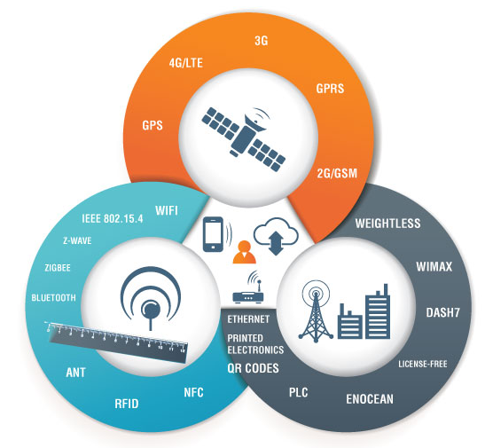

Slide 10
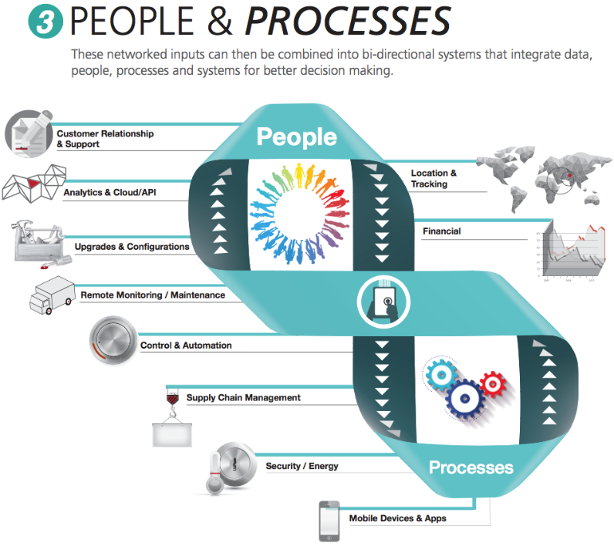

Slide 11
machine/deep learning
Programming vs Machine Learning
Machine learning consente di fare predizioni basandosi su un enorme quantità di dati.
Questa area dell’Intelligenza Artificiale costruisce sul concetto di riconoscimento di modello, e ha l’abilità di generare conoscenza dall’esperienza pregressa in modo indipendente.
Questo è il motivo per cui sta avendo così grande successo nei processi industriali.

Slide 12
Machine (deep) learning approach
Input
Raw data (eg vibration, temperature, image, video,…) about
the behaviour of n components (often obtained by ad hoc platforms) until degradation.
Current (n+1) running component
Output
Prediction on:
Health condition (good/degrading/bad/…)
Remaining useful life (RUL)
Cause of fault
…
Some magic
Innovation: multi-task prediction. Deep Learning can estimate multiple target functions
Data pre-processing
Learn to classify (a function estimated by a ML technique) or estimate RUL (support vector regression), identifying most relevant features
Or directly encode hundreds of time series into a compact internal representation to develop estimators

Slide 13
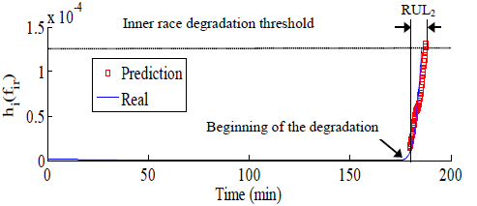
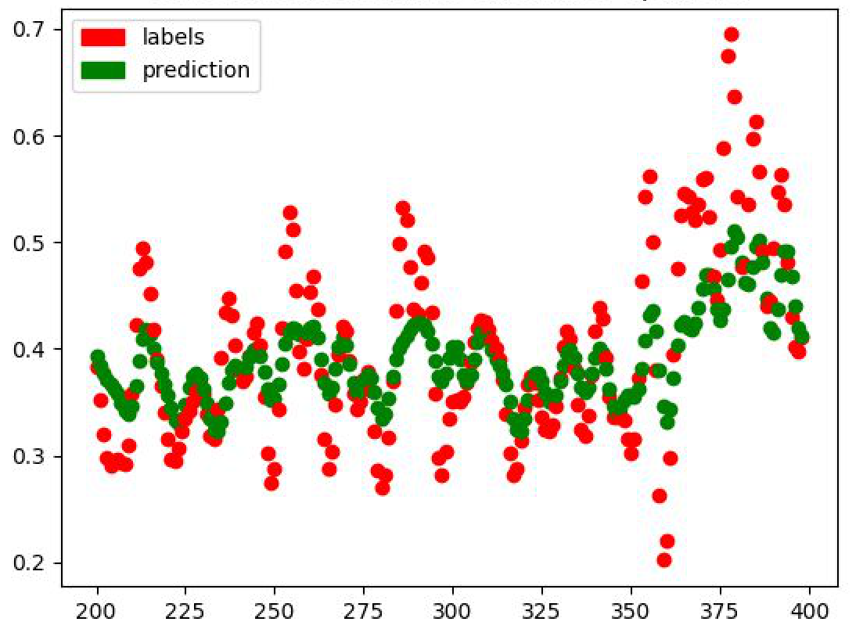
Learning to predict quantitative information (e.g. Remaining Useful Lifetime)
Training sets
{<h_{i-nr}(f_{ir}), … ,h_{i-r}(f_{ir}),h_{i}(f_{ir}),h_{i+1}(f_{ir})>}
{<h_{i-nr}(f_{ir}), … ,h_{i-r}(f_{ir}),h_{i}(f_{ir}), h_{i+2}(f_{ir})>}
…..
Regression
(SVR)
Regression models
Current trace
h_{k-nr}(f_{ir}), … ,h_{k-r}(f_{ir}),h_{k}(f_{ir}),?
Current trace
h_{k-nr}(f_{ir}), … ,h_{k-r}(f_{ir}),h_{k}(f_{ir}), h_{k+1}(f_{ir}),h_{k+2}(f_{ir}), ...

Slide 14
Predictive maintenance

Slide 15
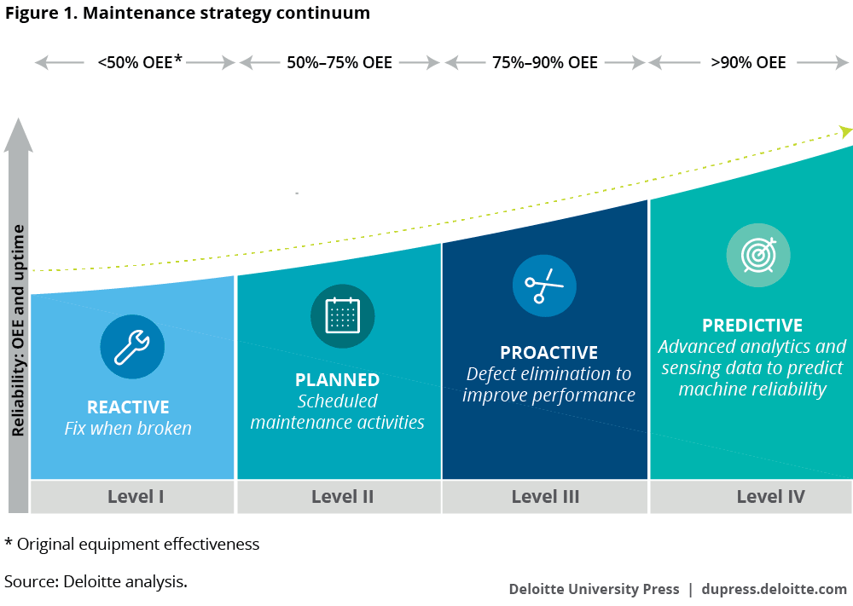

Slide 16
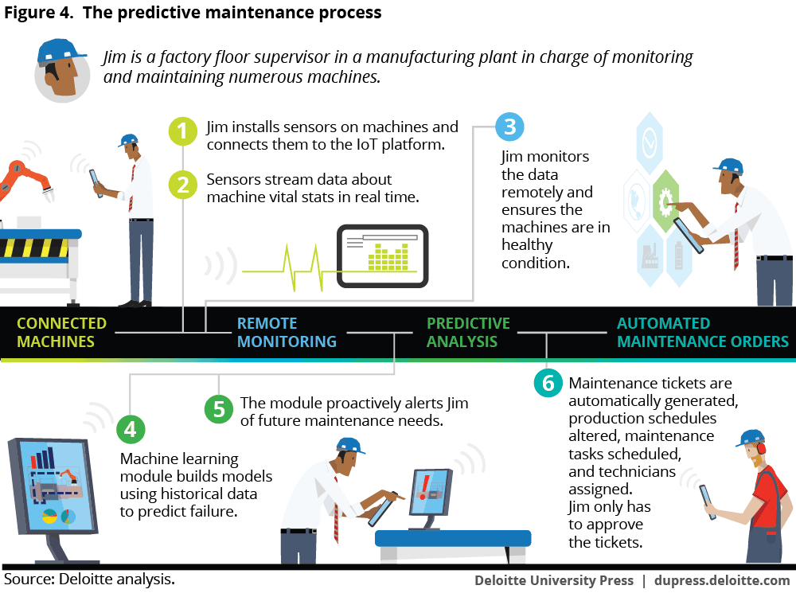

Slide 17
Predictive Maintenance Tools
The predictive maintenance principle is to use a combination of measurements on process and machinery
to evaluate equipment conditions.
Several technologies are available:
Vibration Analysis
Oil Analysis
Performance Test
Thermo Image
NDT/Visual Inspection
…..

Slide 18
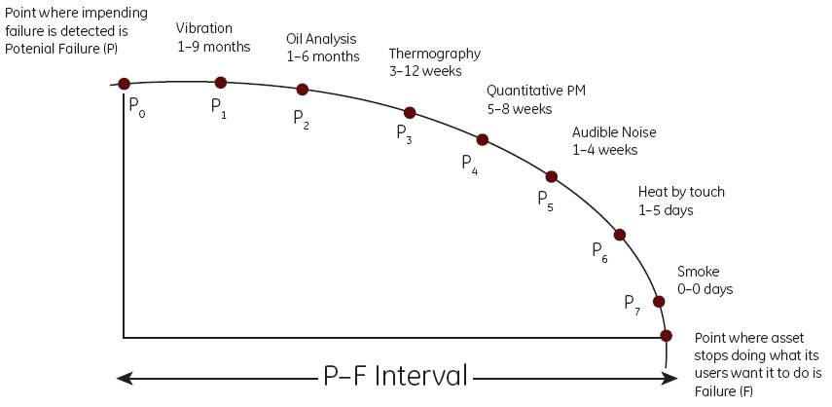
Potential-Failure Curve
The P-F curve chart is one of the most important tools for reliability centered maintenance plan.
Condition/Health status
F
Time

Slide 19
Predictive maintenance
Relies on maintenance based on trends acquired by equipment data
It is based on predicting when an asset needs attention rather than simply replacing a part, when it could last longer
It deals with online data, machine conditions are constantly monitored and data are constantly analyzed
Data acquisition
Data are acquired from the monitored equipment.
Data processing
The acquired data are validated and transformed properly according to the requirements of the decision making techniques.
Decision Making
A number of methods and techniques are applied to obtain the current health condition of the monitored equipment and recommend maintenance plans.

Slide 20
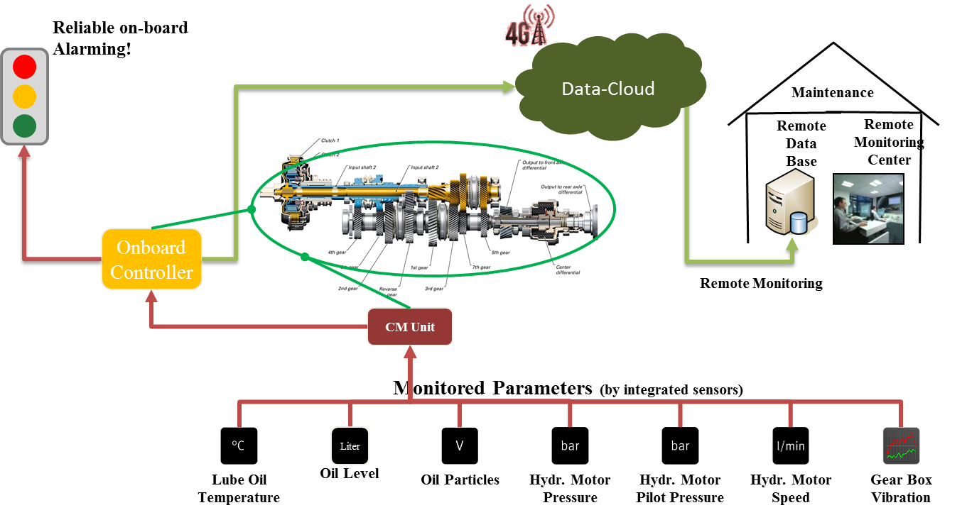
Data Collection and Storage
All the methods described before need to analyze machine data.
Data can be collected from the system by two different methods:
Spot readings: can be performed at regular intervals by using portable instruments.
Continuous readings: Sensors can be retrofitted to equipment or installed during manufacture for continuous data collection.
Collected data is sent to the cloud for storage and for remote monitoring and processing

Slide 21
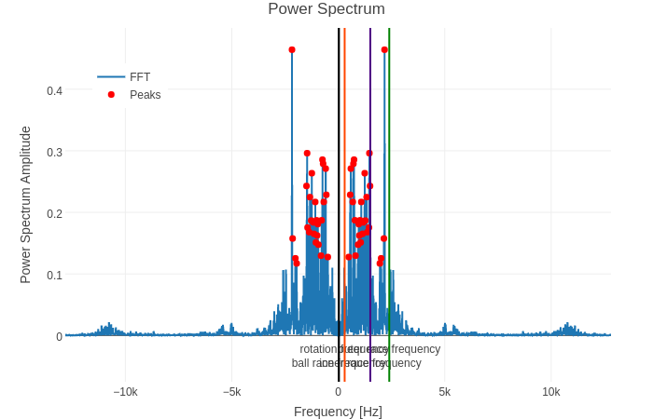
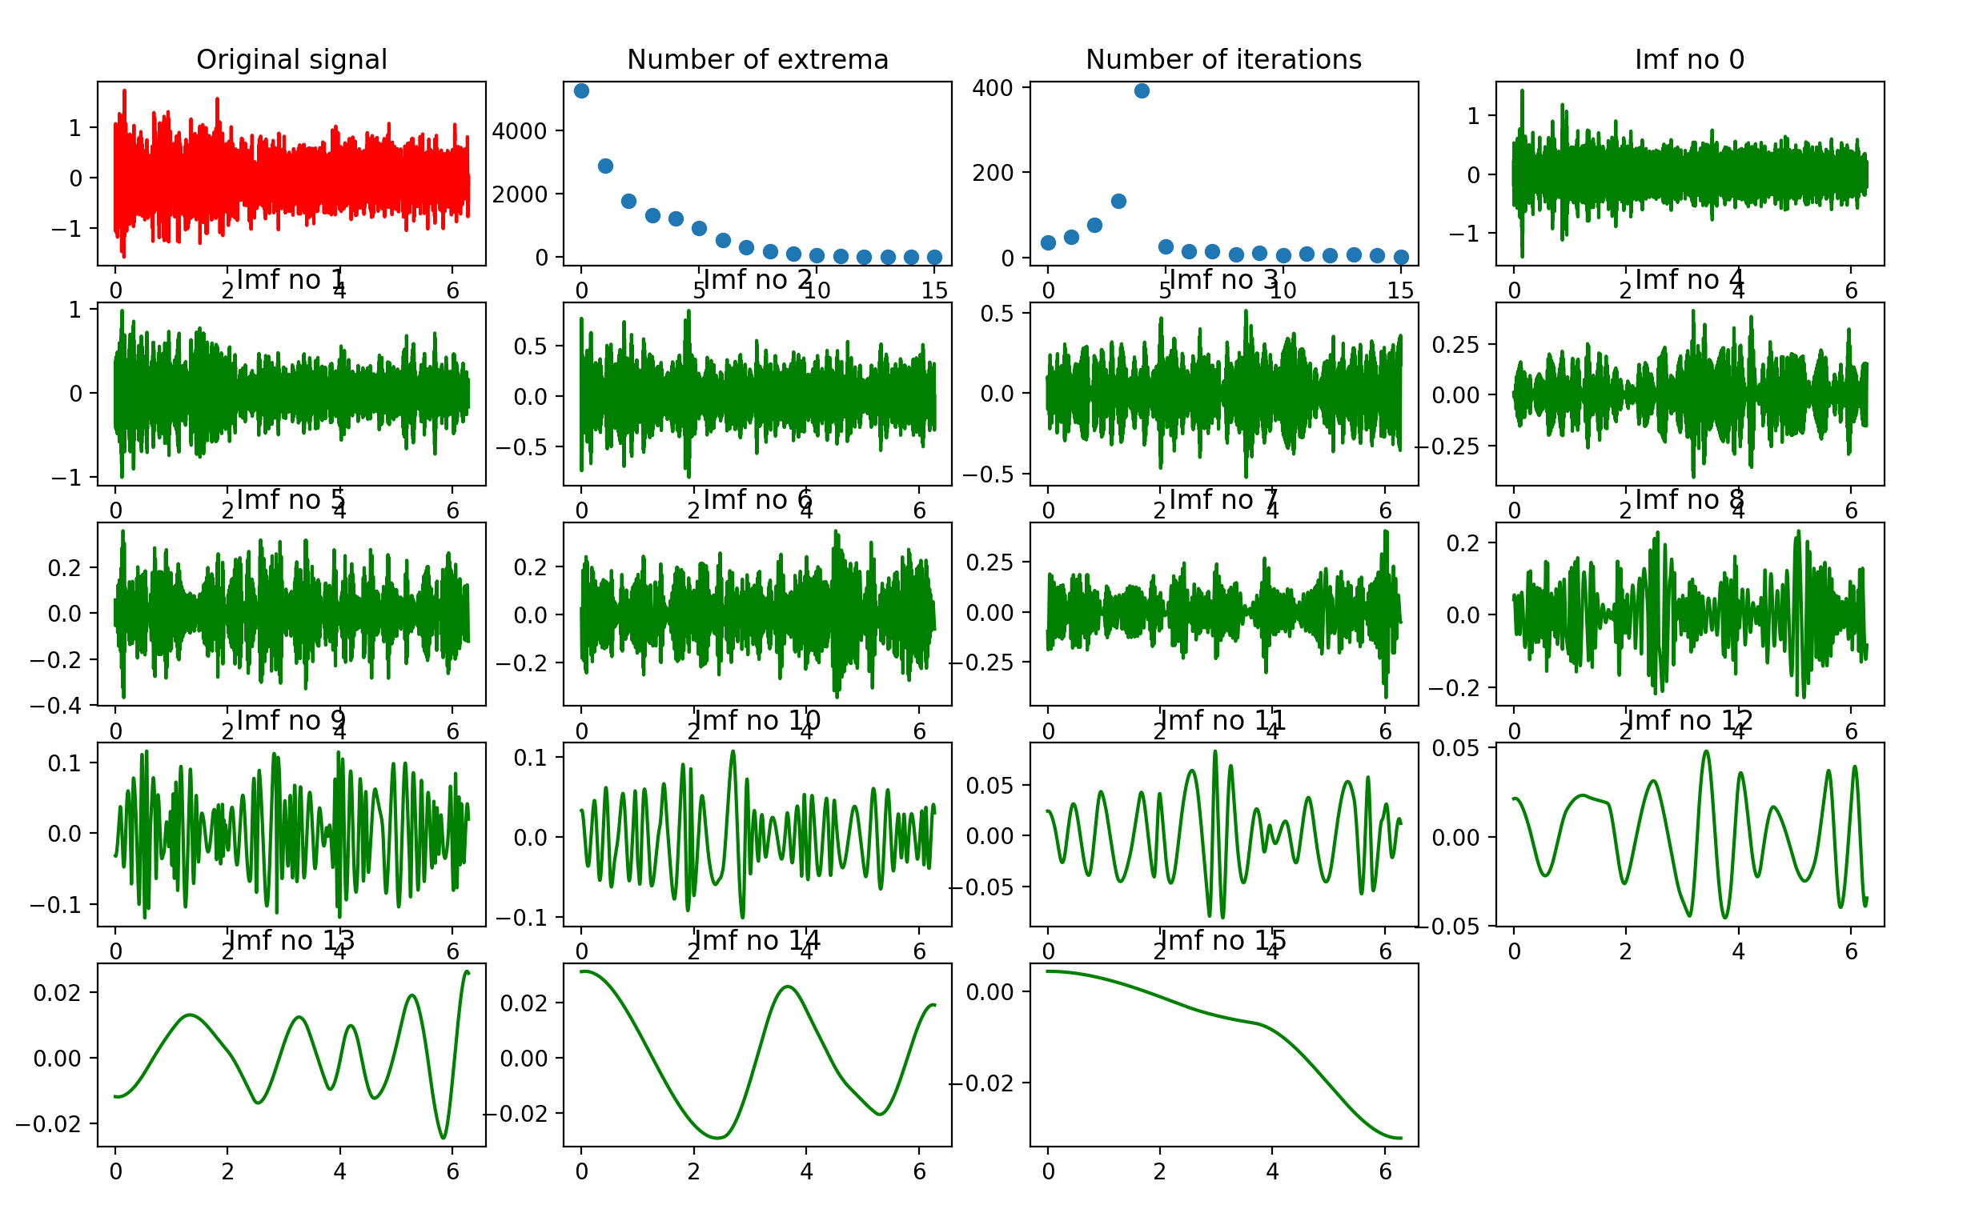
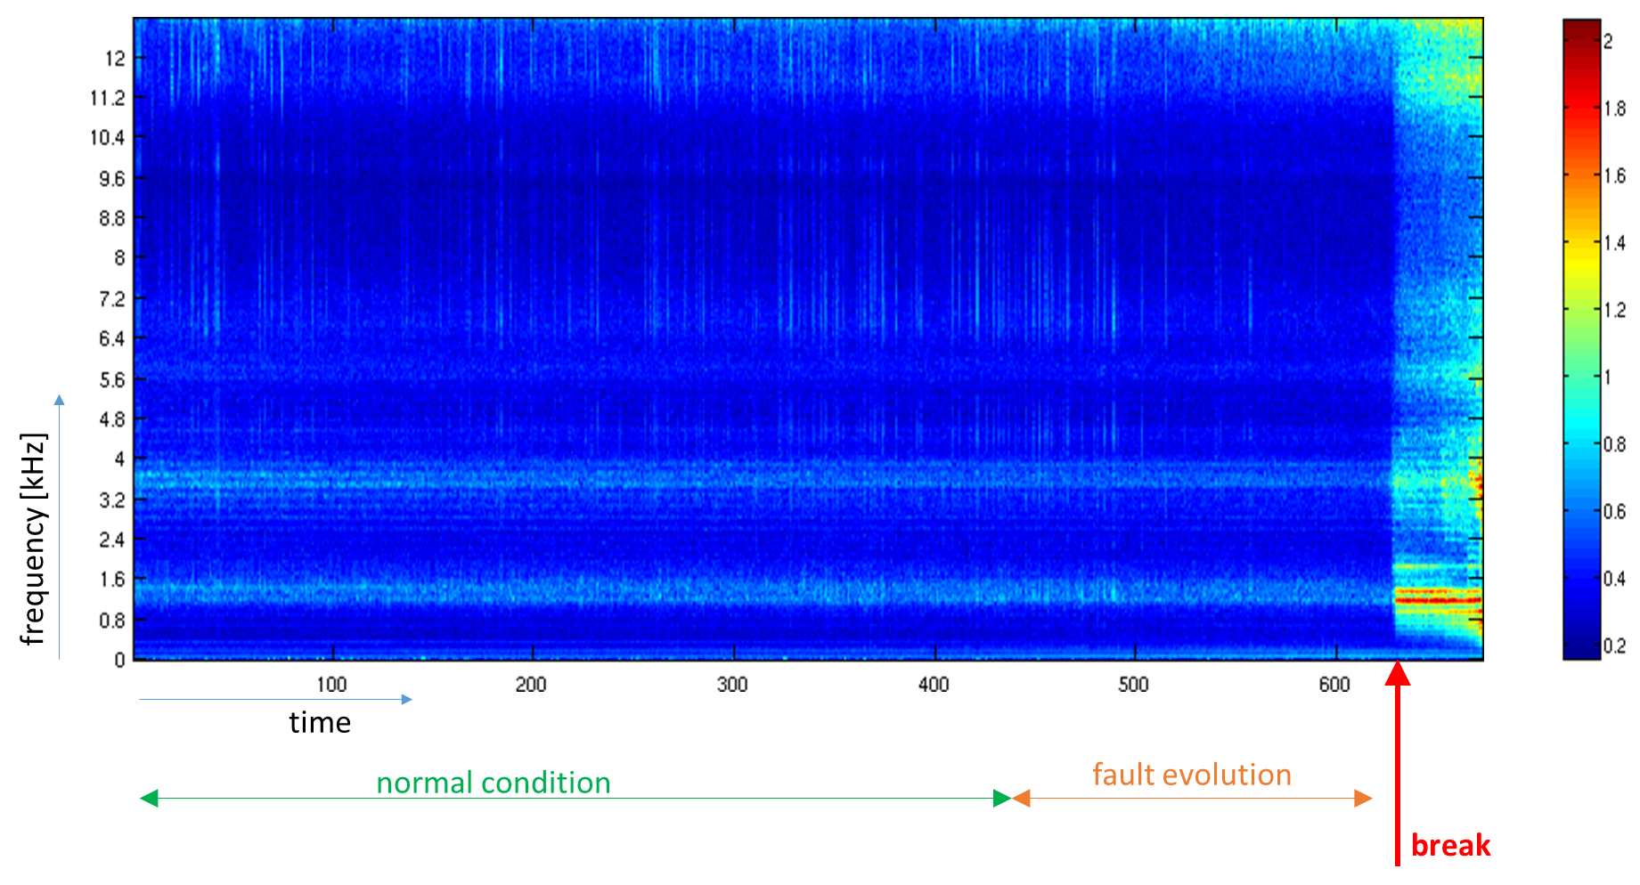
Data Processing
Collected data need to be analyzed to extract useful information to infer health status:
Digital Signal Processing

Slide 22
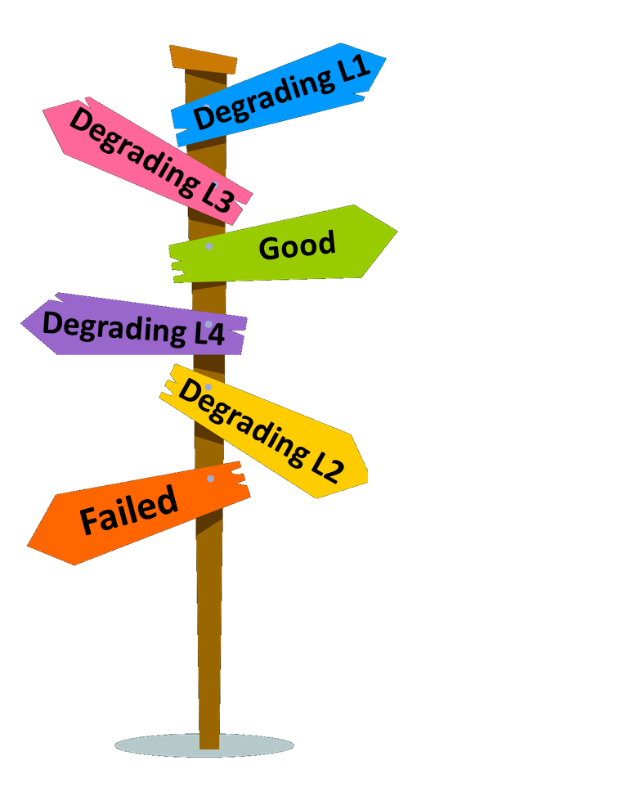

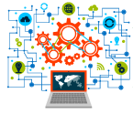

Decision Making
The processed data needs to be analyzed to extract health status and to identify the time to failure
Manual analysis: an human operator visually inspects the acquired and processed data and leveraging on his experience guess the lath status and remaining useful life.
Computer based analysis: Leveraging on decision making support systems like e.g. (deep) machine learning classify the acquired data with health status and predict the remaining useful life.
Domain Expert Human Operator
Machine Learning Algorithms

Slide 23
Machine (deep) learning approach
Input
Raw data (eg vibration, temperature, …) about
the behaviour of n components (often obtained by ad hoc platforms) until degradation.
Current (n+1) running component
Output.
Prediction on:
Health condition (good/degrading/bad/…)
Remaining useful life (RUL)
Cause of fault
…
Some Magic
Two steps + some pre-processing:
Pre-processing of data
Learning to classify (based on ML technique)
Learning to estimate RUL (support vector regression)
…

Slide 24
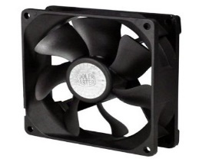
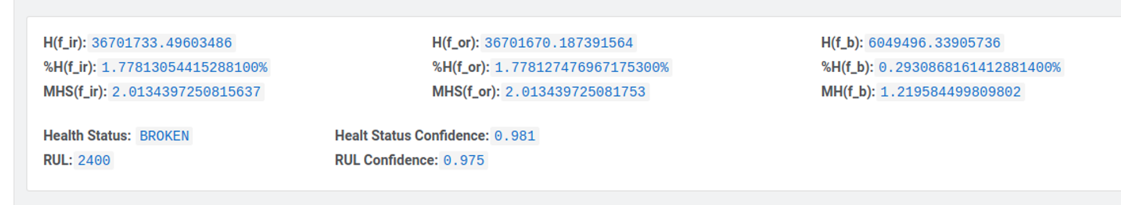

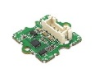

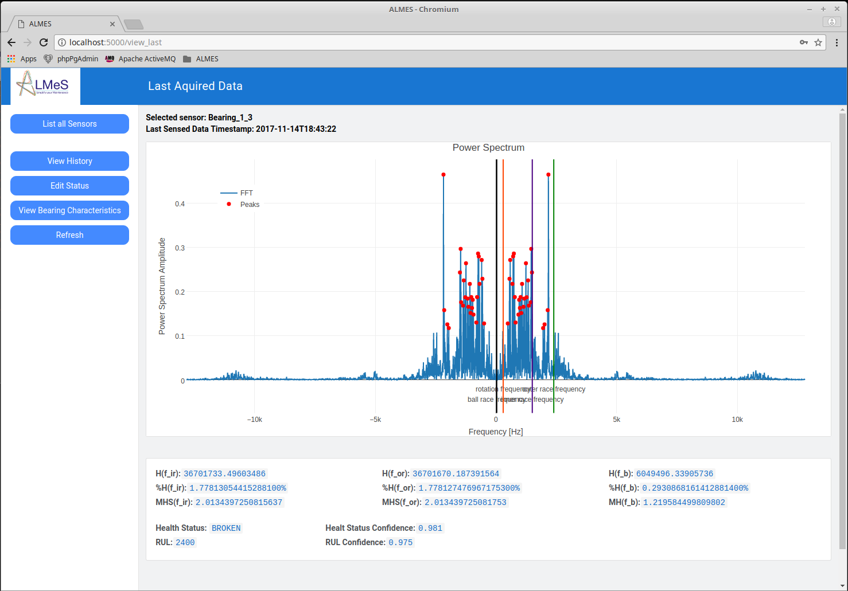
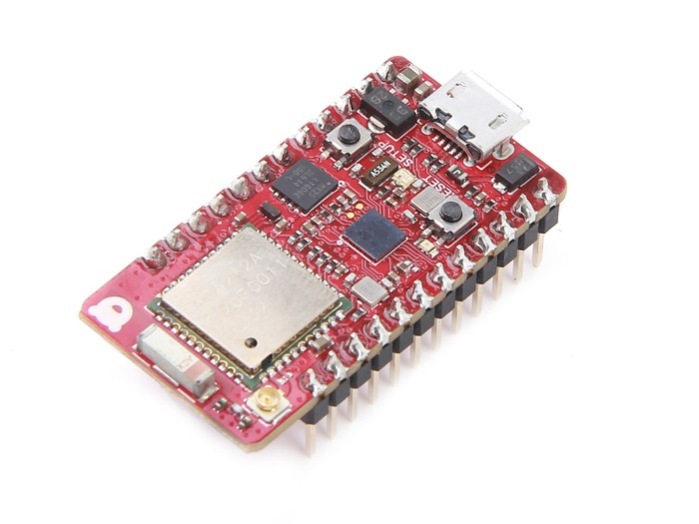

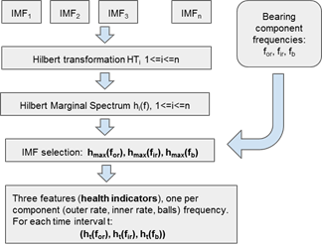
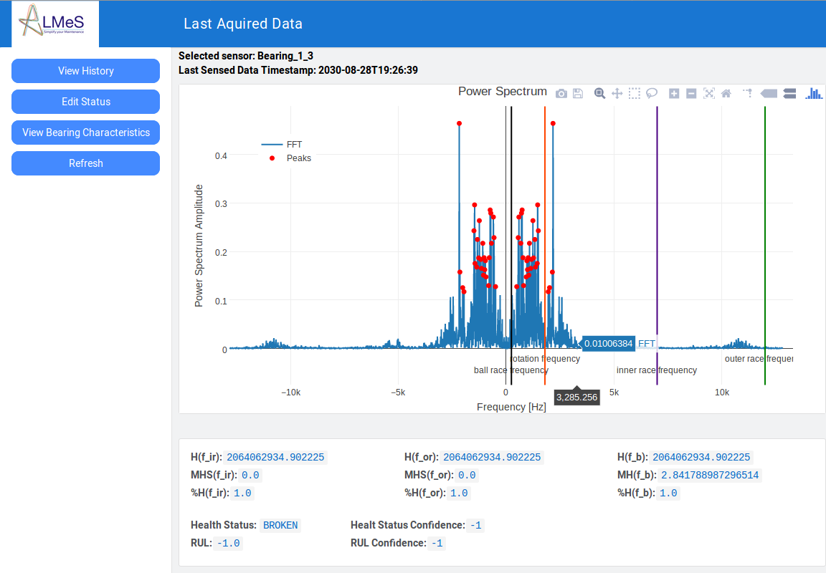

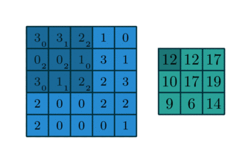
FFT Raw Signal
MQTT Message Broker
Sensor_1 Data_1
FFT Sensor Topic
Cloud Message Handler
Cloud Server
Health Status Topic
Web Server
Health Predictor
1x1x256
1x1x1024
1x1x2048
1x1x512
1x1x2
Dashboard Data Visualization

Slide 25
Internet of things
IoT

Slide 26
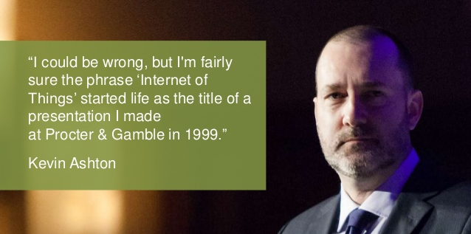

Slide 27
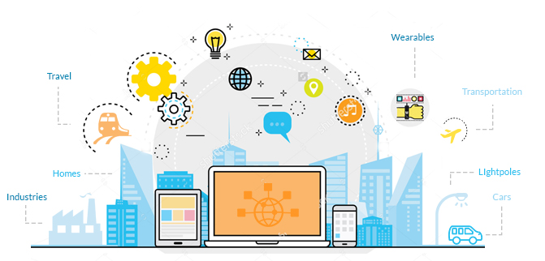
Internet of things: a definition
Network of physical devices, vehicles, home appliances and other items embedded with electronics, software, sensors, actuators, and connectivity which enables these objects to connect and exchange data.
Each thing is uniquely identifiable through its embedded computing system but is able to inter-operate within the existing Internet infrastructure.

Slide 29
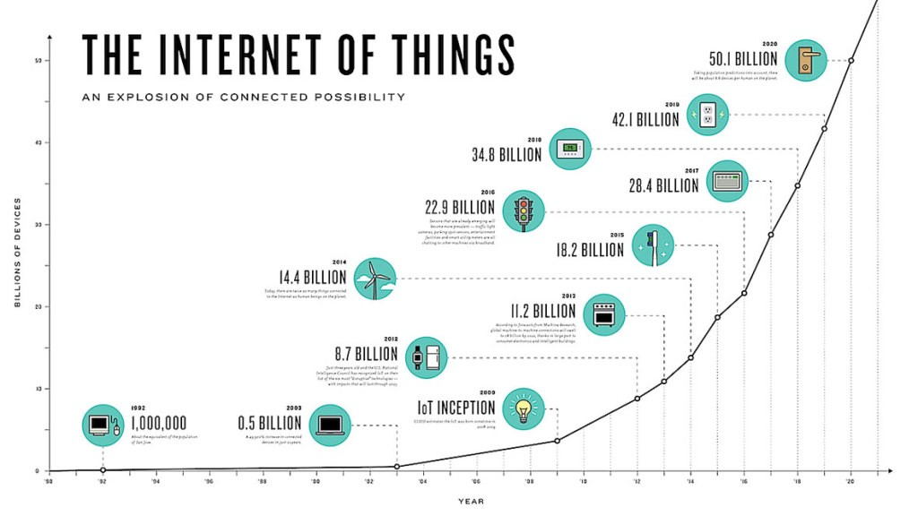
IOT: market growth (Gartner’s forecast)

Slide 30

IOT
Efficient and Saves Time
Saves Money
Better Quality of Life
Loss of privacy and security
Compatibility & Complexity
Technology Takes Control of Life

Slide 31
IOT
Efficient and Saves Time
Saves Money
Better Quality of Life
Loss of privacy and security
Compatibility & Complexity
Technology Takes Control of Life

Slide 32
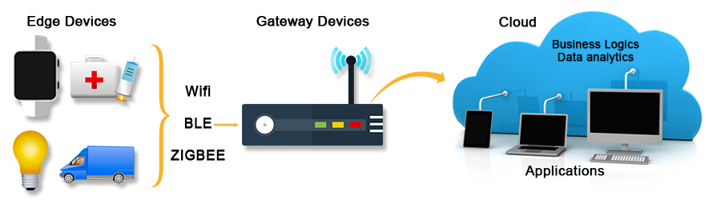
Classic IOT architecture
http://www.eoxys.com/services/internet-of-things.html
Notes:
http://www.eoxys.com/services/internet-of-things.html

Slide 33

Classic IOT architecture: threats (1)
http://www.eoxys.com/services/internet-of-things.html
Notes:
http://www.eoxys.com/services/internet-of-things.html

Slide 34

Classic IOT architecture: threats (2)
http://www.eoxys.com/services/internet-of-things.html
Notes:
http://www.eoxys.com/services/internet-of-things.html

Slide 35
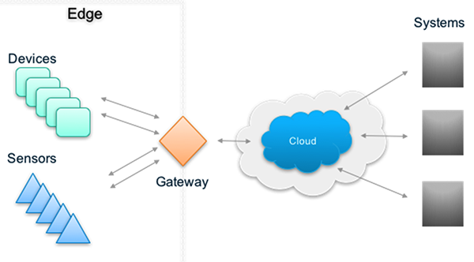
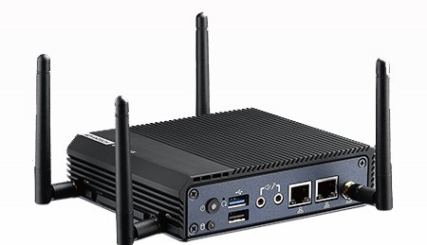
HACKING THE gateway
Bridge the gap between IoT devices and the cloud by providing local storage and computation
Functional challenge: enabling interoperability
Attacks
Physical: Unauthorized access to gateway hardware, and un-authorized geographical movement
Software: Virus, Trojan, Worms, Denial of Services, Jamming. Safety-critical information such as warnings of, e.g., a broken gas line can go unnoticed through DDoS of IoT sensors
Network: Node Capture/Subversion/Malfunctioning, Message Corruption, Routing Attacks
Cryptanalysis: Cipher text only, Known-plaintext, chosen plaintext, MITM
Side Channel Attack: Micro Probing, Reverse Engineering

Slide 36

Classic IOT architecture: threats (3)
http://www.eoxys.com/services/internet-of-things.html
Notes:
http://www.eoxys.com/services/internet-of-things.html

Slide 37
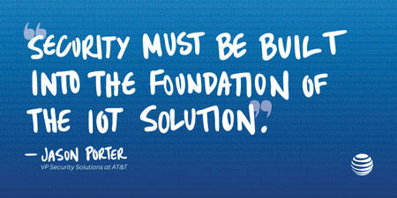
Iot security: theory

Slide 38
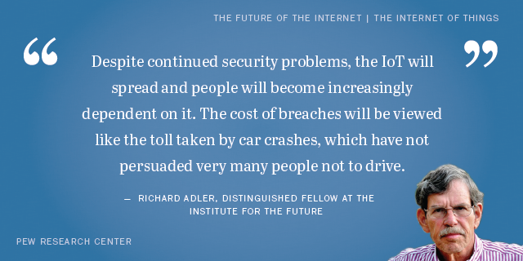
Iot security: practice

Slide 39

A word of wisdom…
You belong on the Internet of Things because you’re a tool

Slide 40
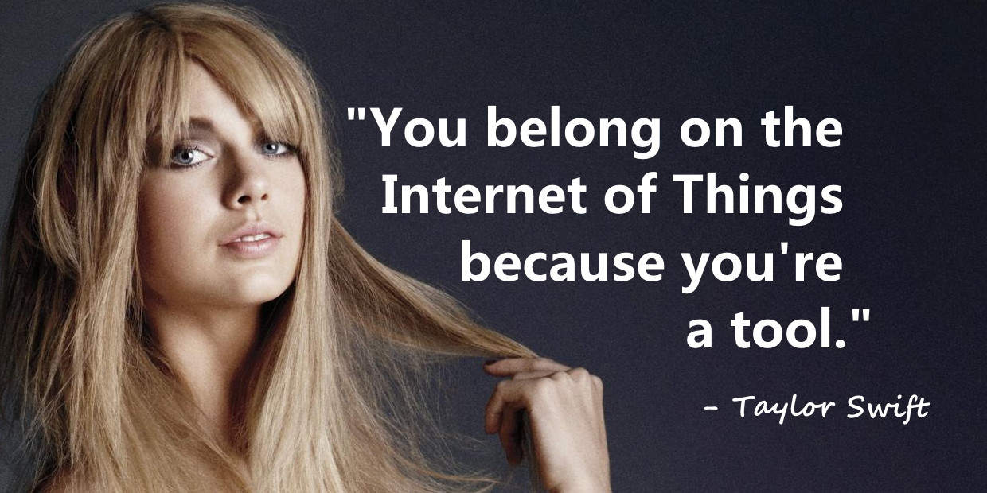
Notes:
https://simonandfinn.com/tag/nietzsche-abyss-quote/

